Slide 1




Sparking Wines – Category Analysis
Presented to Bernard Massard by Univins

Slide 2
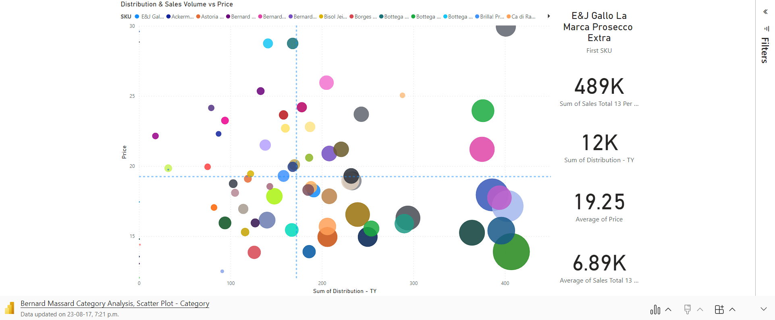
Category Breakdown: Distribution & total Sales vs Price

Slide 3
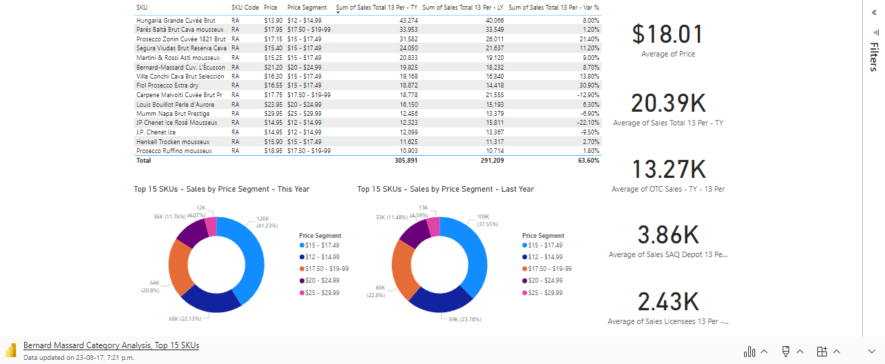
Category Breakdown: Top 15 SKUs by Sales

Slide 4
Category Breakdown: Benchmarks
$8.8 million dollar revenue for the category last month
The Top 15 SKUs generated $5.3 million, capturing 60% of sales in the category
The Average SKU in the Sparkling Wine Category is $19.25
The Average SKU in the Top 15 Selling SKUs ($18.01) is $1.24 cheaper
The majority of top performing SKUs are in the ($15 - $17.49) price segment
The Average SKU in the Sparkling Wine Category sold 6.89k units last month
The Average SKU in the Top 15 SKUs sold 20.4k Units this year – a 4.2% increase from last year
The average SKU sold $124,907.83 last month
The average SKU in the Top 15 sold $355,696.46
All SKUs in the Top 15 SKUs are RA (General Listing) Products

Slide 5
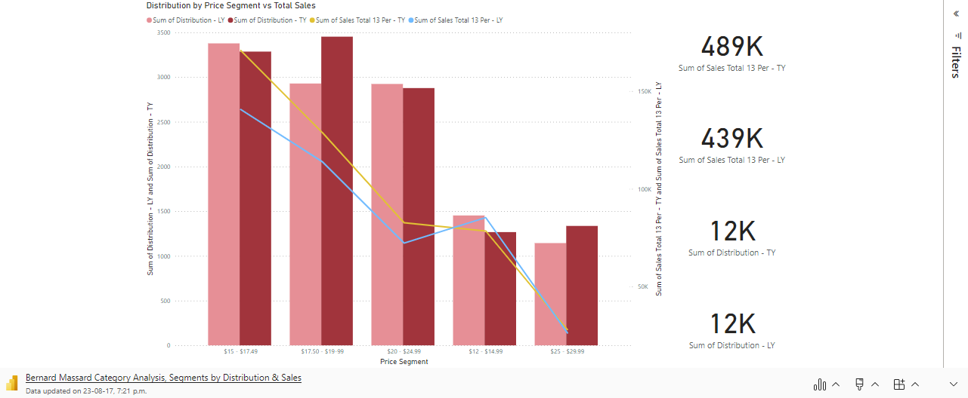
Category Breakdown: Distribution vs total sales – by segment

Slide 6
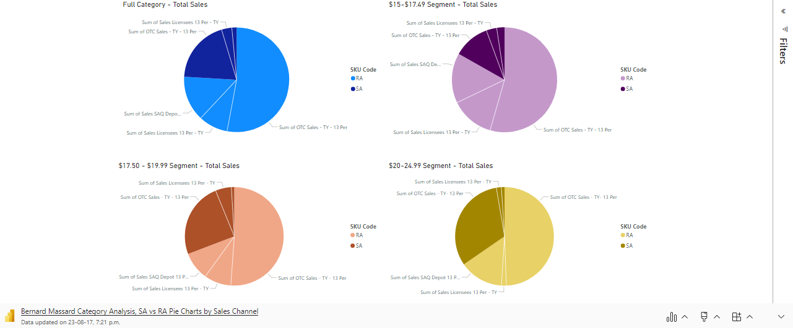
Category Breakdown: RA vs SA - Sales by Channel

Slide 7
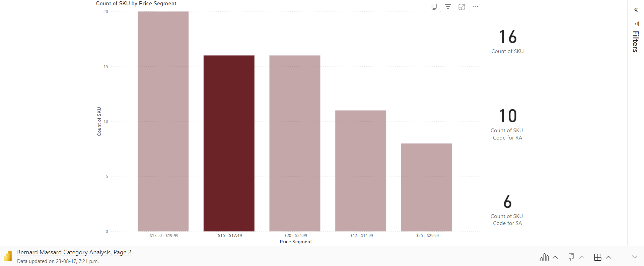
Category Breakdown: Sales by Segment & SKU count

Slide 8
Category Breakdown: Key Insights
Segments Experiencing the Most Sales Growth
$15 - $17.49 price segment grew 21.4% since last year – remains largest segment by sales in the category by a larger margin
$2.74 million dollars in sales last month – 30.9% of sales
Despite slight decline in distribution YOY, this segment saw significant growth across all distribution channels
Licencee Sales lead growth with 151% increase (+$16.5k) followed by SAQ Depot gaining 29% (+$6.7k) and finally OTC Sales growing 6.4% (+$6.4k)
$20 - $24.99 price segment grew 14.4% since last year – remains 3rd largest segment by sales
$1.84 million dollars in sales last month – 20.7% of sales
OTC Sales drove growth gaining 11.6% (+$6.8k) - Licencee sales grow +197% (+1.7k) – SAQ Depot grows 25% (+$1.6k)
$17.50 - $19.99 price segment grew 13.1% since last year – remains 2nd largest segment by sales
$2.36 million dollars in sales last month – 26.6% of sales last month
Significant distribution growth since last year which likely contributed to sales growth
Growth driven by Licencee Sales up 148% (+$10.5k) OTC Sales up 7% (+$6.2k) – SAQ depot sales down 16% (-$2.4k)
Segments Experiencing Declining Sales
The $12 - $14.99 Segment saw an 8% decline in sales, signaling consumers shifting toward products in the higher price segments

Slide 9
Category Breakdown: Key Insights
Segments Distribution
$17.50 - $19.99 price segment had a 524 point uptick in distribution, turning it into the most well distributed segment
$15-$17.49 segment & $20-$24.99 segment hold similar distribution however $15-$17.49 has significantly higher sales
Product Assortment
RA SKUs make up 45% of the category but take up 75% of sales - All SKUs in the top 15 are RA SKUs
SA SKUs dominate the $20-$24.99 segment by SKU count but still make up the minority of sales despite seeing positive growth in SA sales across all segments
The Average SKU in the Top 15 has Very Low Sugar Content
Average Sugar Content sits at 22.6 g/L in Top 15
Omitting outlier Martini & Rossi – Average Sugar Content is 17.2 g/L
Consumers are looking for drier Sparkling Wines.

Slide 10
Category Breakdown: take aways
61% of sales in the sparkling wine category is driven by the $15 - $17.49 segment (34.9%) & $17.50 - $19.99 (26.4%)
Sales in the Licensee distribution channel are seeing exponential growth since last year while OTC continues to generate the vast majority of sales (72.3%)
Licencee Sales increased from 5.5% to 12.6% while OTC sales decreased from 78.5% to 72.3%
Consumer’s are moving away from products in the lowest price segment in favour of higher priced alternatives
Area for further research to identify whats driving this behaviour and whether it will be continued
Focus area for growth

Slide 11
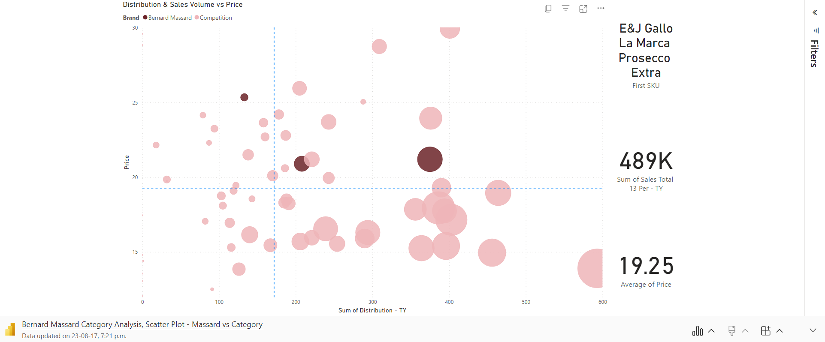
Bernard Massard: Current Positioning

Slide 12
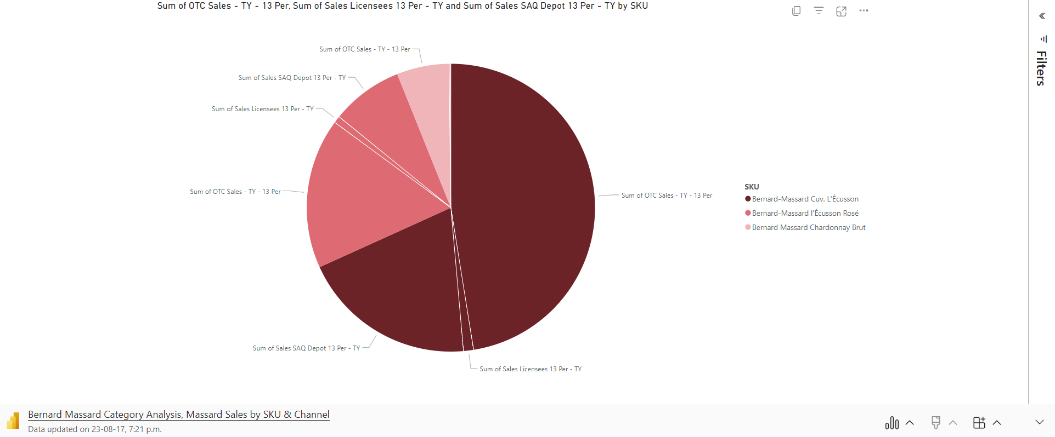
Bernard Massard: Current Positioning

Slide 13
Bernard Massard: Current Positioning
Segments
Bernard Massard is a premium priced brand that currently operates in the two highest price bands in the Sparkling Wines Category - $20-$24.99 & $25-$29.99
The majority of sales is driven by Bernard-Massard Cuvee L'Écusson (68.22% of sales) with Bernard Massard Chardonnay Brut – the highest priced SKU – delivering the smallest amount of sales (less than 6%)
All Bernard Massard SKUs are priced above the average SKU price of $19.25 and even further above the average SKU price in the top 15 best selling SKUs - $18.01
Market Share
Bernard Massard captured a market share of 6.99% this year, down from 7.5% last year
The Category as a whole grew 11.8% while Bernard Massard grew 4.15%

Slide 14
Bernard Massard: SWOT Analysis
Strengths
Top 15 SKU with Bernard-Massard Cuvee L'Écusson
Brand recognition from a top selling SKU with a premium price point (#4 best selling SKU by $)
Weaknesses
Sales in premium products are lagging far behind the rest of the price segment and category
Opportunities
Innovations in the largest price segments
Driving Licensee sales that are seeing significant growth
Special offerings or price drops on products with stagnant sales
Threats
Losing market share – BM is not growing at the same pace as the category as a whole
Loss of premium brand recognition if prices drop too far

Slide 15
Bernard Massard: Reccomendations - Innovation
Releasing Value offerings in the ($15-$17.49) & ($17.50-$19.99) price range
Bernard Massard currently has no products listed in the two larges price bands by sales
Releasing a new product in the largest segment ($15-17.49) presents a huge opportunity to capture the growth in this segment as consumers move toward slightly higher prices options
This segment has a comparatively smaller selection of SA wines available compared to most segments, presenting an opportunity to differentiate in this lucrative segment
Releasing a new product in the second largest segment ($17.50-$19.99) is more consistent with Bernard Massard’s premium offerings & pricing while still gaining exposure to one of the largest and growing segments

Slide 16
Bernard Massard: Recommendations – driving sales growth
Bernard Massard is missing out on the significant increases in Licensee sales that the rest of the category are experiencing
Exploring options to push Licensee sales with our sales team – increased budget to allow discounted load ins and build momentum
Consider special offerings or price drops on premium offerings
Bernard Massard Chardonnay Brut lags behind in sales, a price drop into the $20-24.99 segment could help propel sales
Alternatively, offering more frequent special offering that would drop Chardonnay Brut into the lower price segment could build velocity which could carry over when specials are not on offer, resulting in higher revenues than an outright price drop.
Consider special offerings or price drops on Bernard-Massard L'Écusson Rosé
The same strategy for premium offerings could result in significantly higher sales on the L'Écusson Rosé
Special offerings of price dropping would put L'Écusson Rosé close to the average price point for Top 15 SKUs, a competitive price combined with the brand recognition from Cuvee L'Écusson could help propel this product to significantly higher sales

